Slide 1
Modeling Ant Colony Behavior
Department of Applied Mathematics
University of Colorado-Boulder
Connor Janowiak, Eric Benzel, Erik Bergal
Carly Smith, Donna Kuntzler, John Varkovitzky, Patrick O’Brien, Albert Como, Carrie Weidner, Adam Norris

Slide 2
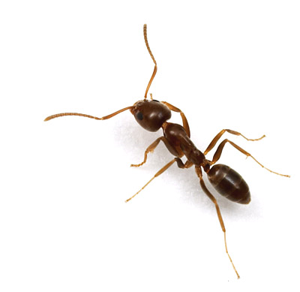
Project History
Deborah Gordon
TED talk www.ted.org
20 years of field research in New Mexico
Continuation of class project from last semester
Now 10 person independent study

Slide 3
About ants
Queen mates once and lives in a dark hole for the rest of her life laying eggs, about 20 years
Each ant is a sterile female who lives about 1 year
Colony dies after when queen dies

Slide 4
Why so Interesting?
There is no central control of any sort
However, global behavior is absolutely necessary for the survival of the colony
How do ants decide what to do without global knowledge?
How does a colony function without a commander?

Slide 5
Colony Behavior
Colony carries on with life from day to day - Find and return food - Remove dead ants and garbage - Feed larvae - Maintain nest and external surroundings
Colony can react to stimuli - Rain - Kids, pets, and other threats
Colonies seem to learn as they age
Despite ephemeral nature of each ant, an old colony responds to stimuli more efficiently

Slide 6
Roles
With the exception of the queen, any ant can have any role
Foragers, nest maintenance, midden workers, patrollers
Reach equilibrium by the end of the day
Younger ants tend to take on roles within the nest, and as they age, they tend to move farther from the nest
Most of population is inactive within the nest

Slide 7
Flow Chart:
Nest Maintenance
Foraging
Midden Work
Patrol
Ants performing certain tasks can only switch to certain other tasks on a given day

Slide 8
Task Switching
Hypothesized to be based on:
Biologically occurs via chemical signaling
Antennae contact
Chemical trails
The behavioral rules are largely unknown

Slide 9
Research Questions
How does an ant decide what task it is performing?
How does the colony respond to external stimuli?
How does the task allocation reach equilibrium?
How does each ant know exactly what each task is?

Slide 10
Existing Models
Dynamic System
Unwieldy – huge amount of parameters undetermined by research
Doesn’t describe the local behavior that we are interested in
(Gordon, 1999)

Slide 11
Existing Models
Network Approach
1
0
Switch task?
1
1
(Gordon; Green; Schaeffer; et. al.)

Slide 12
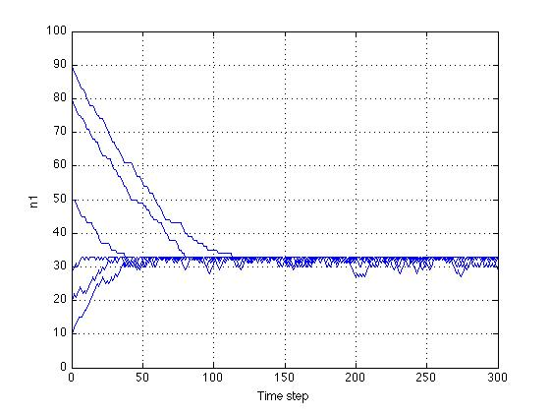
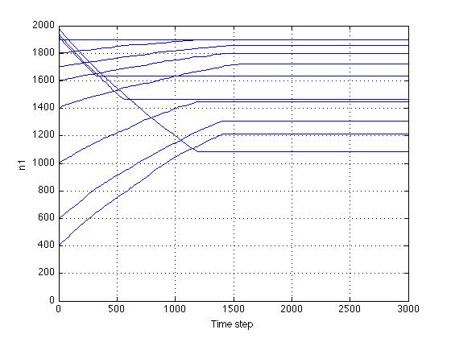
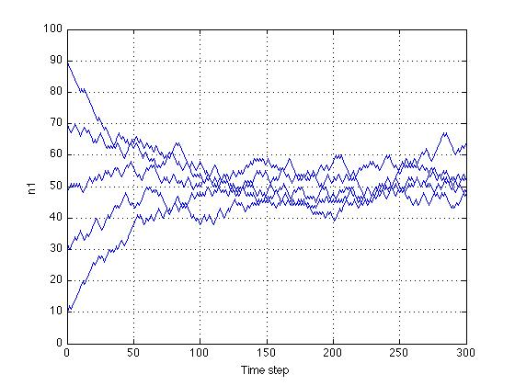
Existing Models
Network Approach

Slide 13
Agent Based Model
Each individual ant, or agent, has its own set of rules
Agents are created and allowed to interact
Basis Behaviors
First utilized by Mataric in robot flocks
For example foraging through
Following other ants, exploring, dispersing, picking up, returning
Many other possible combinations

Slide 14
Termite Example
Randomly distributed blocks are moved into piles that coalesce into a single pile
Rules:
If agent collides with a block and isn’t carrying a block, pick it up
If agent is carrying a block, and there are more than 4 blocks nearby, drop the block
All agents move with a biased random walk
..\..\Science\APPM 4950\0.2\ants.html

Slide 15
After 10 minutes…

Slide 16
Strengths and Weaknesses of the Agent Based Approach
Pros
More accurately simulates the limited knowledge of each ant
Clearly defined algorithms
Easier simulation of physical parameters
Cons
Computationally expensive
Determining basis behaviors

Slide 17
Current Work
Determine what questions can be answered using these methods
What are the reasonable basis behaviors that accurately model field observations
What stimuli should the colony respond to and how

Slide 18
Platforms
Java
..\..\JCreator LE\MyProjects\AntsApp\Antrunner.html
Starlogo

Slide 19
The End Goal?
We are using simple basis behaviors to try and model the complex behavior of social insects
Basis behaviors span an ant
Ant behaviors span colony behavior
Will compare to actual data from Gordon’s research to test the accuracy of our basis behaviors

Slide 20
The Future
Ant colonies act like:
Neural networks
Immune Responses
Human interaction in city planning
Traffic
Social Networks
“if we understand ants, maybe we’ll have a better chance of understanding other organizations”

